Slide 1
Notes of Deep Learning
[1]
Introduction (chapter 1)
[1] Goodfellow, I., Bengio, Y., & Courville, A. (2016). Deep Learning. The MIT Press.

Slide 2
Introduction
Challenge to artificial intelligence:
Solving the tasks that are easy for people to perform but hard for people to describe formally.
Solutions with deep learning :
Learn from experience and understand the world in terms of a hierarchy of concepts, with each concept defined in terms of its relation to simpler concepts.

Slide 3
Introduction
Abstract/Formal Task
Difficult for human, easy for computer.
Knowledge Base
Hard-coded knowledge and reason by logical inference rules.
Machine Learning | Agent
AI acquires their own knowledge via extract patterns from raw data.
Representation Learning
Discover representation itself.
Separate factors of variation that explain the observed data.
Autoencoder
Deep Learning
disentangle
Introduce representations that are expressed in terms of other, simpler representations.
Evolution of different AI technology

Slide 4
Introduction
Perspectives of deep learning:
Learning the right representation.
Depth allows the computer to learn a multi-step computer program:
Each layer of the representation can be thought of as the state of the computer’s memory after executing another set of instructions in parallel.
Not all of the information in a layer’s activations necessarily encodes factors of variation that explain the input.
The representation also stores state information that helps to execute a program that can make sense of the input.

Slide 5
Introduction
Depth of a model
Depth of the computational graph:
Number of sequential instructions that must be executed to evaluate the architecture.
Depth of the probabilistic modeling graph:
Depth of the graph describing how concepts are related to each other.
Compare with ‘shallow’ model:
The study of models that either involve a greater amount of composition of learned functions or learned concepts than traditional machine learning does.
But it is still a technique that allows computer systems to improve with experience and data.

Slide 6
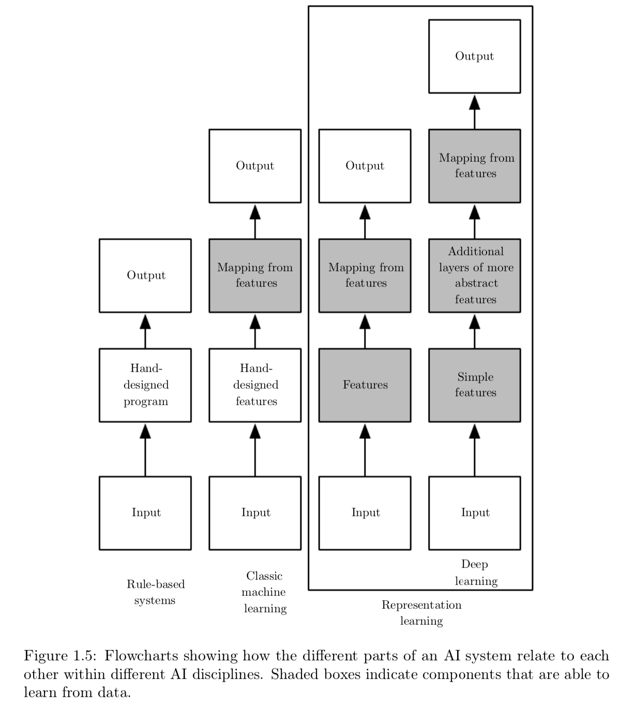
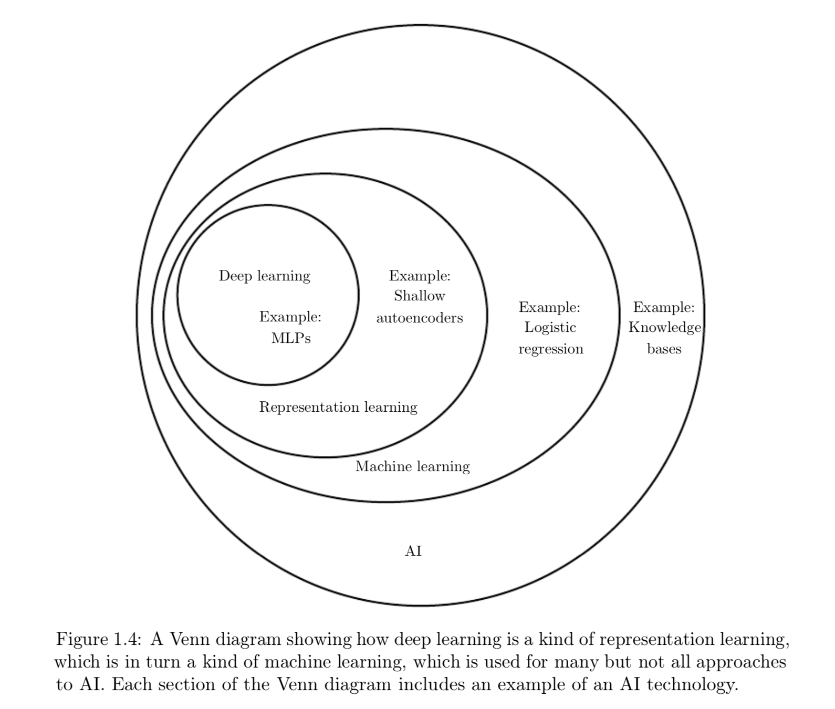
Introduction
Relation between different AI disciplines

Slide 7
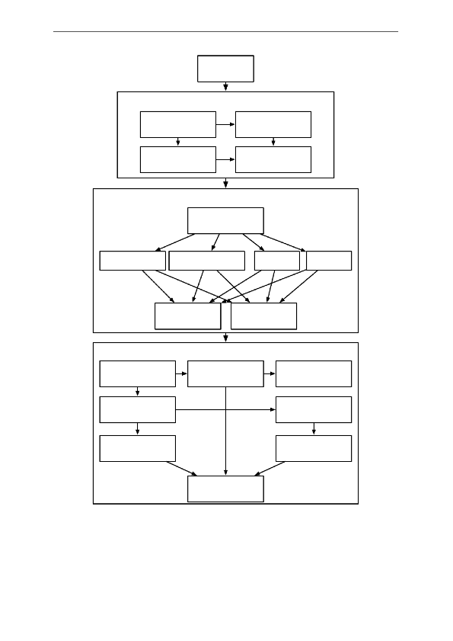
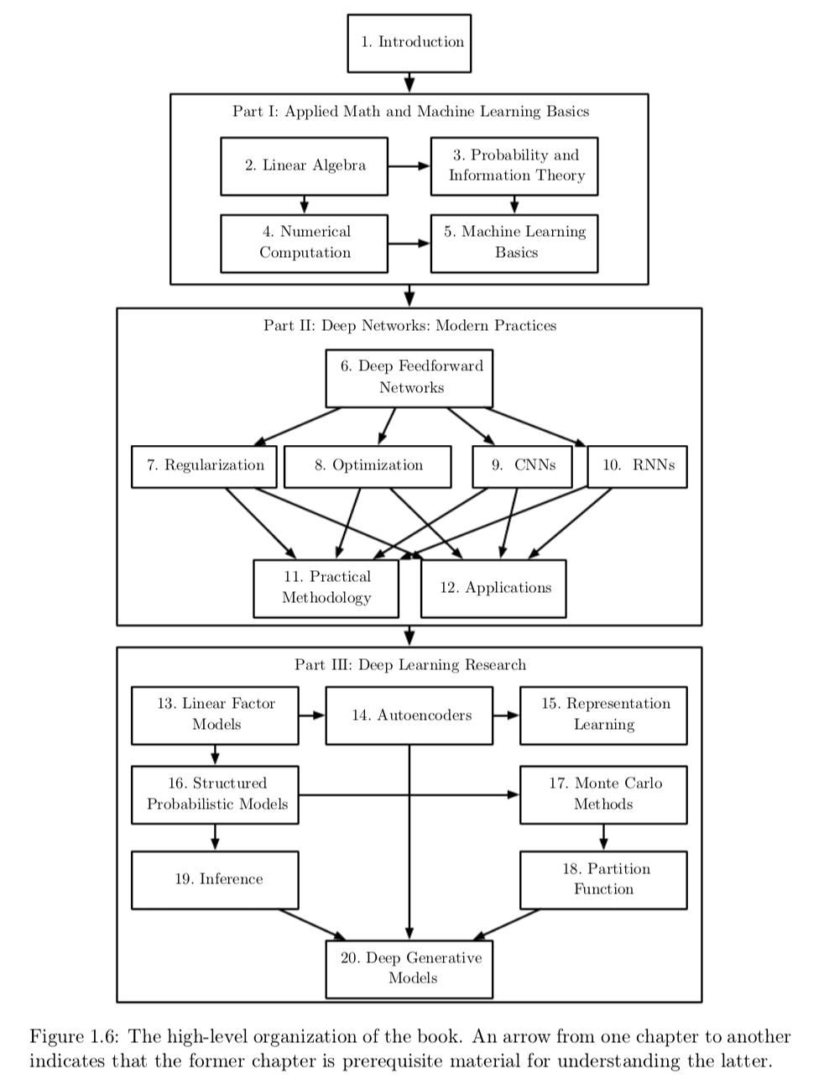
Introduction
Organization

Slide 8
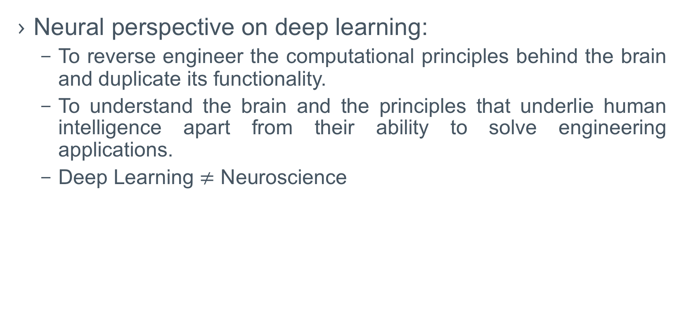
Introduction
Neural perspective on deep learning:
To reverse engineer the computational principles behind the brain and duplicate its functionality.
To understand the brain and the principles that underlie human intelligence apart from their ability to solve engineering applications.
Deep Learning $≠$ Neuroscience

Slide 9
Introduction
Deep learning vs Neuroscience :
Deep Learning
Neuroscience
Hypothesis:
brain use a single algorithm to solve most of different tasks those the brain solves. (Still unknown)
Principle:
learning multiple levels of composition.
Basic idea:
having many computational units those become intelligent only via their interactions with each other.
inspire
Basic idea:
having many computational units those become intelligent only via their interactions with each other.
Target:
build computer systems those are able to solve tasks requiring intelligence.
Target:
build more accurate models of how the brain actually works. (computational neuroscience)

Slide 10
Introduction
Connectionism:
A large number of simple computational units can achieve intelligent behavior when networked together:
Distributed representation*:
Each input represented by many features, each feature involved in the representation of many possible inputs.
Back-propagation

Slide 11
Introduction
Changes:
Increasing dataset sizes
Increasing model sizes
Increasing accuracy, complexity and real-world impact

Slide 12
To be continued…

